Slide 1
Chapter 10 Electronic Commerce Payment Systems

Slide 2
LEARNING OBJECTIVES
Understand the shifts that are occurring with regard to online payments.
Discuss the players and processes involved in using credit cards online.
Discuss the different categories and potential uses of smart cards.
Discuss various online alternatives to credit card payments and identify under what circumstances they are best used.
Describe the situations where e-micropayments are used and the alternative ways for handling these situations.
Describe the processes and parties involved in e-checking.

Slide 3
THE PAYMENT REVOLUTION
Crucial factors in determining whether a particular method of e-payment achieves critical mass:
Independence
Interoperability and Portability
Security
Anonymity
Divisibility
Ease of Use
Transaction Fees
International Support
Regulations

Slide 4
USING PAYMENT CARDS ONLINE
payment card
Electronic card that contains information that can be used for payment purposes.
Three forms of payment cards:
Credit cards
Charge cards
Debit cards

Slide 5
USING PAYMENT CARDS ONLINE
PROCESSING CARDS ONLINE
authorization
Determines whether a buyer’s card is active and whether the customer has sufficient funds.
settlement
Transferring money from the buyer’s to the merchant’s account.

Slide 6
USING PAYMENT CARDS ONLINE
Merchants use three basic configurations for processing online payments:
Own the payment software
Use a point of sale system (POS) operated by an acquirer
Use a POS operated by a payment service provider
payment service provider (PSP)
A third-party service connecting a merchant’s EC system to the appropriate acquiring bank or financial institution. PSPs must be registered with the various card associations they support.

Slide 7
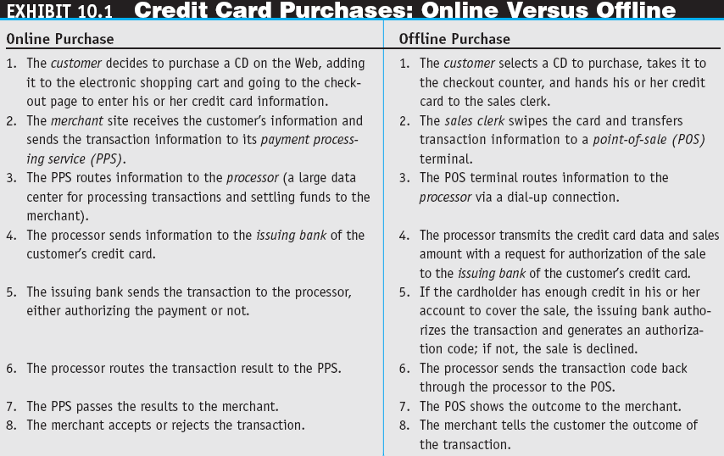

Slide 8
USING PAYMENT CARDS ONLINE
Key tools used in combating fraud:
Address Verification System (AVS)
Detects fraud by comparing the address entered on a Web page with the address information on file with the cardholder’s issuing bank.
Manual review
Fraud screens and automated decision models

Slide 9
USING PAYMENT CARDS ONLINE
card verification number (CVN)
Detects fraud by comparing the verification number printed on the signature strip on the back of the card with the information on file with the cardholder’s issuing bank.
Card association payer authentication services
Negative lists

Slide 10
SMART CARDS
smart card
An electronic card containing an embedded microchip that enables predefined operations or the addition, deletion, or manipulation of information on the card.

Slide 11
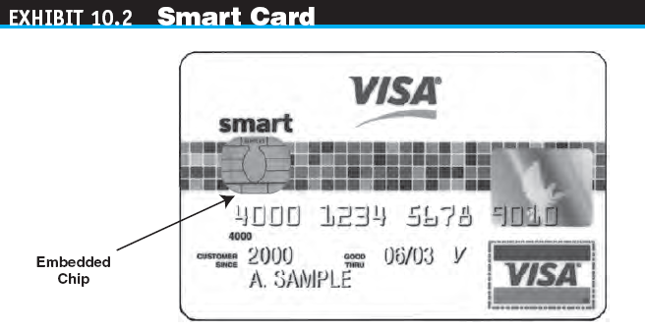

Slide 12
SMART CARDS
TYPES OF SMART CARDS
contact card
A smart card containing a small gold plate on the face that when inserted in a smart card reader makes contact and passes data to and from the embedded microchip.
contactless (proximity) card
A smart card with an embedded antenna, by means of which data and applications are passed to and from a card reader unit or other device without contact between the card and the card reader.

Slide 13
SMART CARDS
smart card reader
Activates and reads the contents of the chip on a smart card, usually passing the information on to a host system.
smart card operating system
Special system that handles file management, security, input/output (I/O), and command execution and provides an application programming interface (API) for a smart card.

Slide 14
SMART CARDS
APPLICATIONS OF SMART CARDS
Retail Purchases
Transit Fares

Slide 15
STORED-VALUE CARDS
stored-value card
A card that has monetary value loaded onto it and that is usually rechargeable.

Slide 16
E-MICROPAYMENTS
e-micropayments
Small online payments, typically under $10.
Five basic micropayment models that do not depend solely or directly on credit or debit cards:
Aggregation
Direct payment
Stored value
Subscriptions
À la carte

Slide 17
E-CHECKING
What is e-Cheque?
e-Cheque is an electronic counterpart of paper cheque. It turns the cheque writing and deposit processes totally online. Paying with e-Cheques will be an entirely paperless experience

Slide 18
E-cheque Flow (for banks which provide e-cheque issuance and presentment services on their own)
4B
Payer
Alternatively, payer can send e-cheque to payee via email (if payer wishes to send e-cheque to payee, probably together with other documents)
Payee
Digital signed
e-cheque
4A
Send e-cheque to payee by payer’s bank by email
1
3
through Internet Banking or other authenticated means
5
Request for issuing
e-cheque
Digital signed
e-cheque
Digital signed
e-cheque
Digital signed
e-cheque
Present
e-cheque through Internet Banking or other means
2
Create
e-cheque
6
8
HKICL
7
Verify
signature, payee identity and
credit deposit
9
Inward clearing file and signed
e-cheques
Outward clearing file and signed
e-cheques
Verify signature, internal records and check for duplicate presentments
Clear and settle
e-cheque
Payer’s Bank
Payee’s Bank

Slide 19
E-CHECKING in Hong Kong
Benefits
Can be issued anytime anywhere
Removes the need for physical delivery and deposit
Carries enhanced security features
Removes the need of physical cheque book. The e-Cheque book is kept by the paying bank
It is environmentally friendly

Slide 20
E-CHECKING in Hong Kong
Key features
It is in PDF format and it has similar layout of a paper cheque with the display of a standardized e-Cheque logo on the face of e-Cheque
It has the same legal status as paper cheque
It is not negotiable nor transferable
It must be addressed to a payee and deposited to the payee’s bank account only
It can be used to make Hong Kong Dollar, US Dollar and Renminbi payments

Slide 21
E-CHECKING in Hong Kong
How secure is e-Cheque?
The payer is required to pass through Two Factor Authentication (2FA) before issuing an e-Cheque
The e-Cheque issuance record kept by the paying bank provides an additional channel for the bank to verify the e-Cheques
Adoption of Public Key Infrastructure (PKI) technology in the digital signature of e-Cheque prevents e-Cheque tampering
Centralized presentment checking mechanism avoids multiple deposits of e-Cheques
The payer may consider encrypting an e-Cheque before delivery to further improve security

Slide 22
E-CHECKING in Hong Kong
How secure is e-Cheque?
The payer is required to pass through Two Factor Authentication (2FA) before issuing an e-Cheque
The e-Cheque issuance record kept by the paying bank provides an additional channel for the bank to verify the e-Cheques
Adoption of Public Key Infrastructure (PKI) technology in the digital signature of e-Cheque prevents e-Cheque tampering
Centralized presentment checking mechanism avoids multiple deposits of e-Cheques
The payer may consider encrypting an e-Cheque before delivery to further improve security

Slide 23
E-CHECKING in Hong Kong
Issuance of e-Cheque
Step 1 – Log onto your Internet banking account
Step 2 – Select e-Cheque Issuance service
Step 3 – Input the payee name, cheque date and
cheque amount in figures
Step 4 – The bank will generate the e-Cheque with
the digital signature based on the payer’s
given instruction
Step 5 – Download and send the e-Cheque to the
payee through electronic means (e.g. by email)

Slide 24
E-CHECKING in Hong Kong
e-Cheques presented to Hong Kong Interbank Clearing Limited (“HKICL”) on Day D are sorted and dispatched to drawee banks overnight.
E-Cheques can be deposit through the payer’s internet banking account of his/her bank or through the e-Cheque Drop Box service through its website http://www.echeque.hkicl.com.hk or mobile application

Slide 25
E-CHECKING in Hong Kong
Deposit of e-Cheque through your bank
Step 1 – Log onto your Internet banking account
Step 2 – Select e-Cheque Deposit service
Step 3 – Choose the deposit account and upload the
e-Cheques that you have received

Slide 26
O!ePay
O!ePay is a network-based stored value service operated and Octopus Cards Limited that enables an O!ePay account holder to perform person-to-person payment with other O!ePay account holder.

Slide 27
O!ePay
3 Major features:
Person-to-person Payment
Fund Transfer between O!ePay Account and Registered Octopus
User can add value to his/her O!ePay account via authorized partners of Octopus

Slide 28
e-Hongbao (e-Lai-see)
Setup and Operates
supports Hong Kong dollar only
WeChat Wallet must link to Visa or MasterCard
Two ways to send hongbao to friends or relatives:
The user can setup a fixed amount and insert money into the red-pocket then system will randomly distribute lucky money to the selected group of friends and relatives.
The user can also send lucky money to a dedicated friend or relative electronically.

Slide 29
e-Hongbao (e-Lai-see)
Major service providers of e-Hongbao in Hong Kong
TNG
Hong Kong Telecom (Tap & go)
Standard Chartered Bank and WeChat (Tencent)

Slide 30
MANAGERIAL ISSUES
What payment methods should your B2C site support?
What e-micropayment strategy should your e-marketplace support?
What payment methods should the C2C marketplace support?
Should we outsource our payment gateway service?
How secure are e-payments? What is the required security to use Internet banking?

Slide 31
Order Fulfillment
The following slides on Order Fulfillment are taken from Online File W10.1 available on the book’s Web site at www.pearsonhighered.com/turban

Slide 32
Order Fulfillment
Order Fulfillment and Logistics—an Overview
order fulfillment
All the activities needed to provide customers with their ordered goods and services, including related customer services.

Slide 33
Order Fulfillment
back-office operations
The activities that support fulfillment of orders, such as packing, delivery, accounting, and logistics.
front-office operations
The business processes, such as sales and advertising, that are visible to customers.

Slide 34
Order Fulfillment
logistics
The operations involved in the efficient and effective flow and storage of goods, services, and related information from point of origin to point of consumption.

Slide 35
Order Fulfillment
The EC Order Fulfillment Process
Step 1: Making sure the customer will pay
Step 2: Checking for in-stock availability
Step 3: Arranging shipments
Step 4: Insurance
Step 5: Replenishment

Slide 36
Order Fulfillment
Step 6: In-house production
Step 7: Use contractors
Step 8: Contacts with customers
Step 9: Returns
reverse logistics
The movement of returns from customers to vendors.

Slide 37
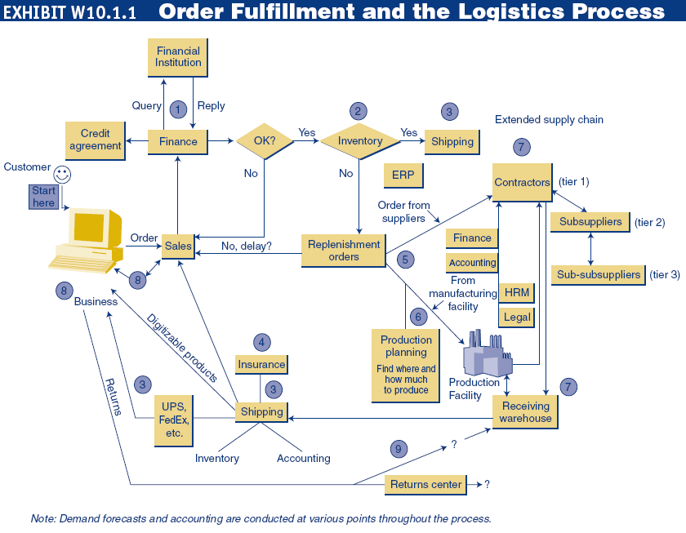

Slide 38
Order Fulfillment
Order Fulfillment and the Supply Chain
e-logistics
The logistics of EC systems, typically involving small parcels sent to many customers’ homes (in B2C). E.g. Shun Fung Express (www.sf-express.com)

Slide 39
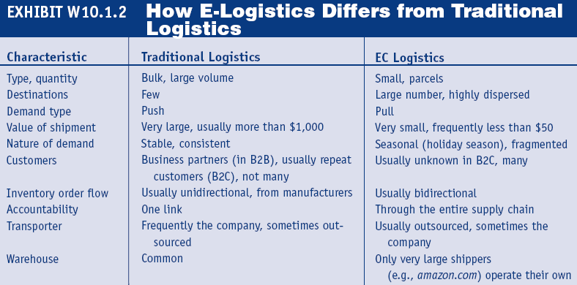

Slide 40
Addressing Problems in Order Fulfillment
Typical Supply Chain Problems
Demand forecasting is difficult
Many of the problems along the EC supply chain stem from the need to coordinate several activities, internal units, and business partners in the face of uncertainties
third-party logistics suppliers (3PL)
External, rather than in-house, providers of logistics services.

Slide 41
Addressing Problems in Order Fulfillment
Solutions to Order Fulfillment Problems
Improvements in the Order-Taking Process
Warehouse management system (WMS)
A software system that helps in managing warehouses.
Other Inventory Management Improvements
Automated Warehouses

Slide 42
Addressing Problems in Order Fulfillment
Partnering Efforts and Outsourcing Logistics
Comprehensive Logistics Services
Speeding Deliveries
Handling Returns (Reverse Logistics)
Return the item to the place of purchase
Separate the logistics of returns from the logistics of delivery
Completely outsource returns
Allow the customer to physically drop the returned item at a collection station
Auction the returned items

Slide 43
Addressing Problems in Order Fulfillment
Order Fulfillment in B2B
Using BPM to Improve Order Fulfillment

Slide 44
